Slide 1
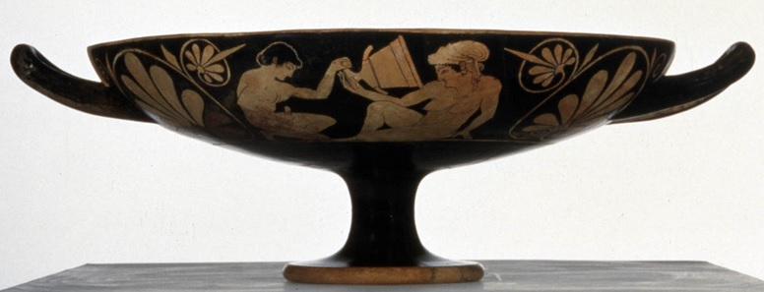
Joke’s On Him: Caricature and Male Clients of Prostitutes on Greek Vase-Painting
Alexander Mazurek – aemazure@buffalo.edu
April 3, 2014
The Classical Association of the Middle West and South 110th Annual Meeting

Slide 2
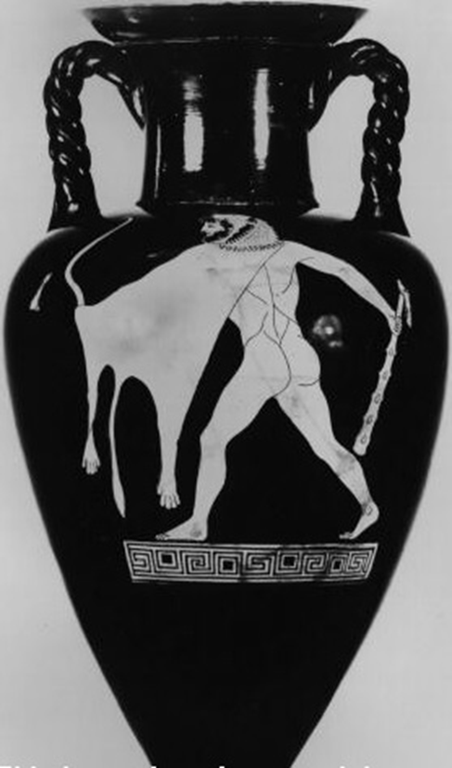
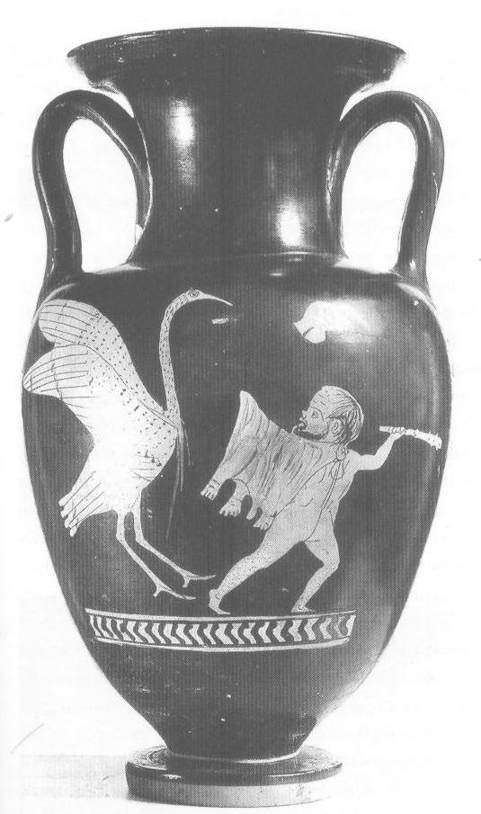
“Comedic Mechanisms”
Visual Puns
Situation Comedy
Parody
Caricature
Parody of Herakles

Slide 3
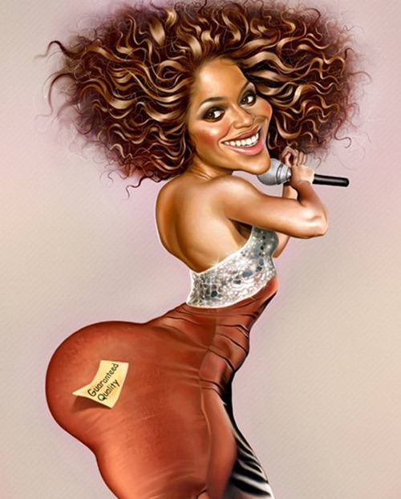
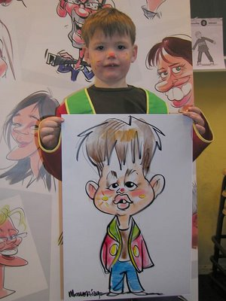
Caricature Today

Slide 4
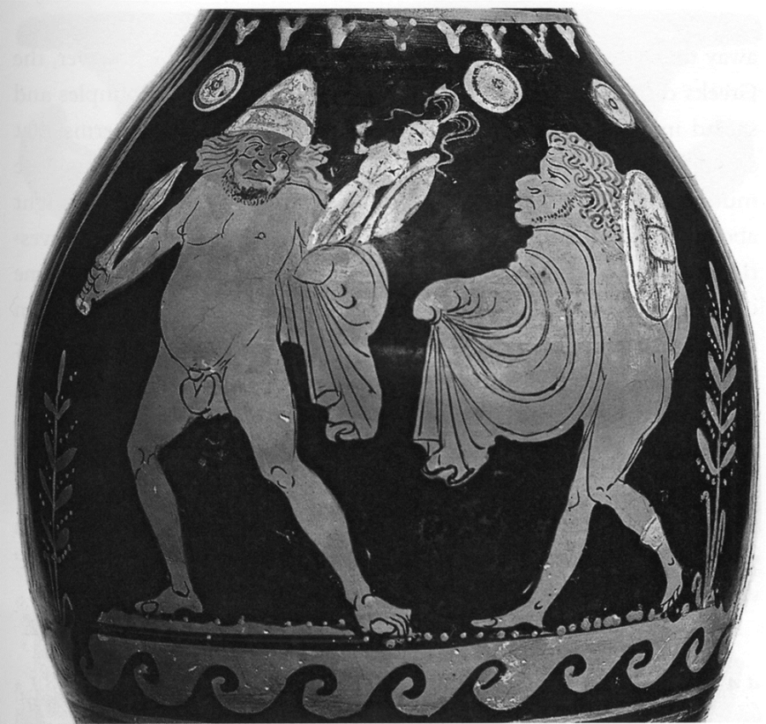
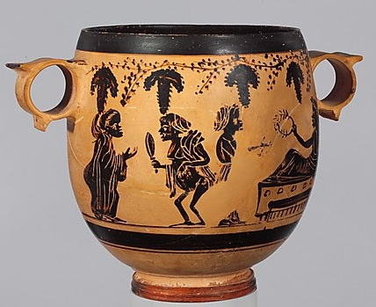
History of Caricature
Apulian Red-Figure
Felton Painter
350 BCE
Boeotian Kabeiric
Vine Tendril Group
350 BCE

Slide 5
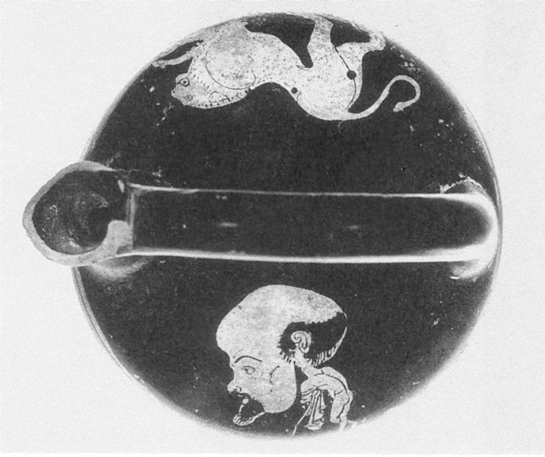
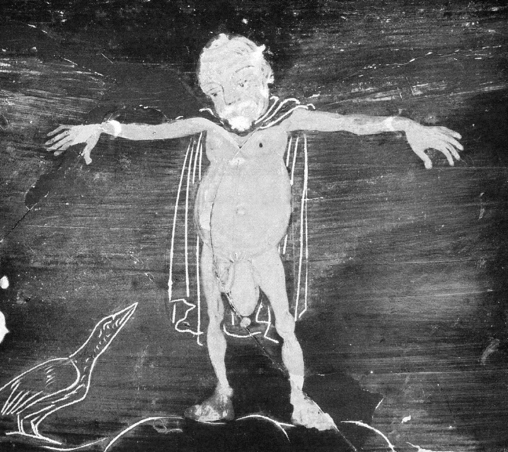
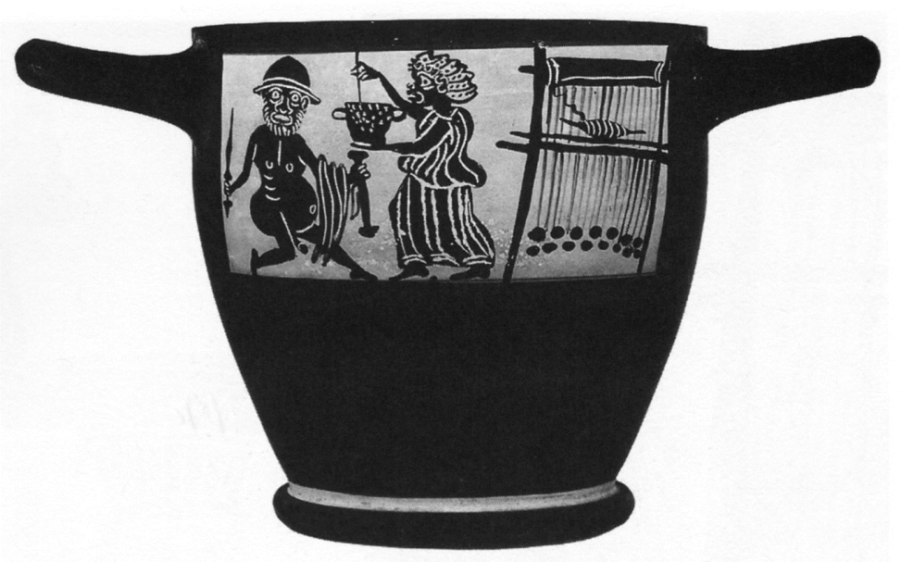
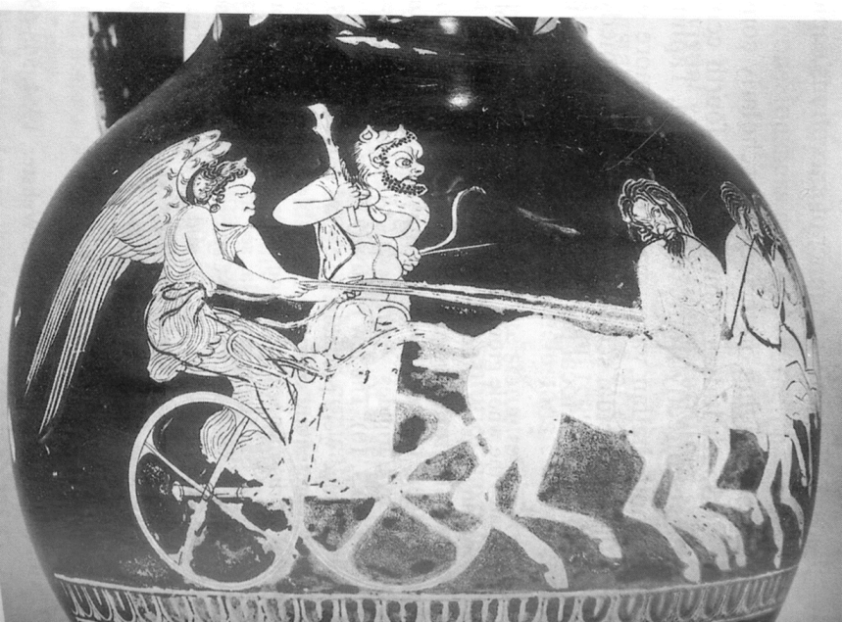
The Wide World of Caricature

Slide 6
Phintias Red-Figure Kylix
Side A
Side B
510 BCE
J Paul Getty Museum, Malibu
80.AE.31

Slide 7
Same Woman?

Slide 8
Same Man?

Slide 9
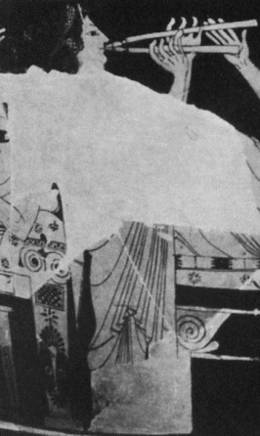
Identification as Syko?
Euphronios
Attic Red-Figure Krater
525-475 BCE
Antikensammlungen, Munich 8935

Slide 10
Identity of the Male
Side A
Smikros

Slide 11
Side A

Slide 12
Mockery of Old Prostitutes
“But you, old bag, are tweezed and plastered, the Grim Reaper’s heartthrob.” (Ar. Assemblywomen 904-5)
“A monkey plastered with makeup? A hag arisen from the underworld?” (Ar. Assemblywomen 1072-3)

Slide 13
Side B

Slide 14
Oinophile Painter
Attic Red-Figure Lekythos
510-480 BCE
British Museum 1922.10-18.1

Slide 15
Metropolitan Museum of Art, 09.39
14 – 68 CE
Copy of 2nd C. BCE Greek Original
Glyptothek, Munich
Copy of Late 2nd C. BCE Greek Original

Slide 16
The Good and The Ugly
Phintias
Red-Figure Hydria
550-500 BCE
Antikensammlungen, Munich 2421

Slide 17
Brygos Painter
Red-Figure Donkey-Head Rhyton

Slide 18
Bibliography
Frel, J. Greek Portraits in the J. Paul Getty Museum. Malibu, CA: Getty Museum, 1981.
Keuls, Eva C. The Reign of the Phallus: Sexual Politics in Ancient Athens. New York: Harper & Row, 1985.
Keuls, Eva. "The Social Position of Attic Case Painters and the Birth of Caricature." Proceedings of the 3rd Symposium on Ancient Greek and Related Pottery: Copenhagen, August 31-September 4, 1987. Ed. Jette Christiansen and Torben Melander. Copenhagen: Nationalmuseet, 1988. 300-13.
Kilmer, Martin F. Greek Erotica on Attic Red-Figure Vases. London: Duckworth, 1993.
Lewis, Sian. The Athenian Woman: An Iconographic Handbook. London: Routledge, 2002.
Mitchell, Alexandre G. Greek Vase-painting and the Origins of Visual Humour. New York, NY: Cambridge University Press, 2009.
Mitchell, Alexandre G. "Humour in Greek Vase-Painting." Revue Archéologique 37.1 (2004): 3-32.
Stafford, Emma. “Clutching The Chickpea: Private Pleasures of the Bad Boyfriend.” Sociable Man, Essays on Ancient Greek Social Behaviour, In Honour of Nick Fisher. Ed. S.D. Lambert. Swansea: The Classical Press of Wales, 2011. 337-363.
Sutton, Robert F., Jr. "The Good, The Base, and The Ugly: The Drunken Orgy in Attic Vase Painting and the Athenian Self." Not The Classical Ideal: Athens and the Construction of the Other in Greek Art. Ed. Beth Cohen. Leiden: Brill, 2000. 180-202.
Weiss, Carina. “Phintias in Malibu und Karlsruhe.” Greek Vases in the J. Paul Getty Museum: 4. Ed. Jiri Frel. Malibu, CA: Getty Museum, 1989. 83-94.

